Slide 1
Developing Your Church’s Covenant
For In-Person Worship
Pinnacle
Leadership
Associates

Slide 2
Webinar Objectives
Explore the meaning of covenant
Why covenant around reopening for worship?
Process for developing a covenant
Investigation
Education
Collaboration
Communication
Discussion

Slide 3
What?
What is a covenant?
A Definition
a formal and serious agreement or promise
From Latin
com: “together” + venire: “to come”
Notes:
5 Biblical covenants:
Noah, rainbow, never destroy earth
Abraham, to provide the land
Moses, on stone, 10 commandments
David, establish a son of David as eternal sovereign
Messianic, promise of salvation for God’s peoples Covenant we’re most familiar with now is marriage, separate and distinct from legal arrangement

Slide 4
Social Contract
What is a Social Contract?
A social contract is an agreement for mutual benefit between an individual or group and the community as a whole.
A social contract is a way to live into the “golden rule”—“do unto others as you would have them do unto you.”
Seventeenth century philosopher Thomas Hobbs made the point that, if people aren’t willing to set aside some of their own wants in favor of the good of all, society can only exist in chaos.
A covenant can serve as a social contract within a congregation.
Notes:
Covenant in this situation is more like a social contract. What is a social contract? What personal “wants” might we need to sacrifice in “favor of the good for all” as we contemplate a return to worship?

Slide 5
Why?
Why have a covenant for reopening?

Slide 6
Why?
“I want to know that others are being as safe as I am being.”
Alleviate chaos
Minimize anxiety
Communication tool for members & guests
A positive way to frame new protocol
Why have a covenant for reopening for worship?
Notes:
My church did a survey, exploring readiness of parishioners to return to in person worship, the stand-out comment was "I want to know that others are being as safe as I am being?" A covenant/social contract helps alleviate many question marks people will bring to a return to worship. 1. Alleviate chaos. More specifically, alleviate conflict. Have you been in situations where someone was ugly to someone not wearing a mask or not 6' away? I've seen this at the grocery store. 2. Minimize anxiety. When people aren't sure of expectations, they may feel anxious about what they should be doing, as well as what others may or may not do. Having something in print, spelling out new protocol goes a long way to alleviate anxiety. 3. Communication tool. A covenant is a simple way to communicate protocol for members as well as guests. It also demonstrates a spirit of working together toward a common goal . . . in this case, worshipping in shared space in the safest possible way during a pandemic. 4. It's a way to frame new protocol in a positive way. Instead of, "We CAN'T sing, hug, etc" a covenant is a way to say, "We CAN work together to provide the safest possible way back to worship/"

Slide 7
Example
To mask or not to mask?
Notes:
To mask or not to mask. . .this was the biggest point of contention within my board. We had one person who feels claustrophobic in a mask, and perhaps a political "conscientious objector." Our solution was to provide alternatives for those who can't/won't wear masks, including live-streaming our worship in another part of our facility, as well as online. We are also exploring launching an outdoor worship service where masks will be optional.

Slide 8
Process
How can my church create a covenant for reopening?

Slide 9
Process for Creating a Covenant for Reopening
Investigate
Collaborate
Communicate
Educate
Know the facts.
Share your knowledge.
Work together.
Share your plan.

Slide 10
Investigate
Become an Expert
Learn CDC recommendations for faith-based communities. https://www.cdc.gov/coronavirus/2019-ncov/community/faith-based.html?CDC_AA_refVal=https%3A%2F%2Fwww.cdc.gov%2Fcoronavirus%2F2019-ncov%2Fphp%2Ffaith-based.html
Know state & local policies. If your state offers no criteria for reopening of churches, consider following directives for movie theaters. (Example: Florida is at Phase 2 reopening; movie theaters can be at 50%.)
Discover best source for tracking state & local COVID-19 cases. Avoid news outlets and go straight to the government source.
Study best practices for cleaning & disinfecting, social distancing, etc.
Know the facts.

Slide 11
Educate
Teach Your People
They don’t know who/what to believe. They’ll believe you.
Use your platform to educate. Newsletter, e-news, social media, video, worship.
Simplify the message.
Example: Top Three
Social Distance
Wear Masks
Wash Hands
Parish nursing. Now may be a good time to enlist a paid or volunteer parish nurse.
Medical Professionals Roundtable
Share the facts.

Slide 12
38:52-40:12

Slide 13
38:54-40:12

Slide 14
Collaborate
Seek Consensus
Solicit feedback from church members about reopening. surveymonkey.com
Work together.

Slide 15
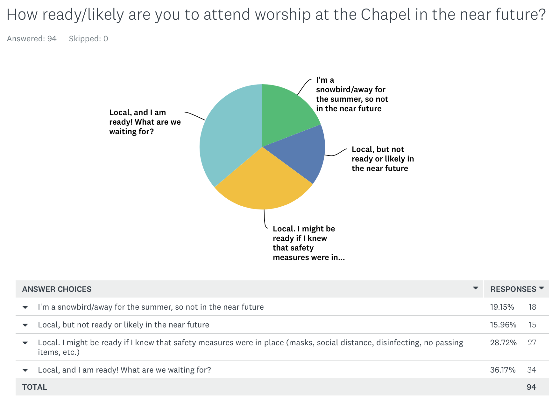

Slide 16
Collaborate
Seek Consensus
Solicit feedback from church members about reopening. surveymonkey.com
Analyze feedback.
With education and feedback in place, draft a proposal for covenant and discuss with leadership team.
“All of us have opinions; some of us make decisions.”
Work together.

Slide 17
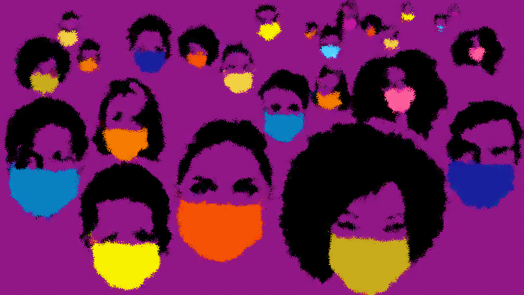
“We share responsibility
for keeping each other safe.”

Slide 18
Covenant for Returning to Worship
“I want to know that others are being as safe as I am being.”

Slide 19
Communicate
Communicate
Determine your plan for communicating your covenant with your members and guests.
Website
Bulletin
Posters
Video
Other
Share the plan.

Slide 20
Communicate
Ushers can be the “front line”
for helping worshippers
know and follow your
covenant.
Consider a “soft
opening” for church
leaders and ushers
with an usher
training to
follow.

Slide 21
Discussion

